Slide 1
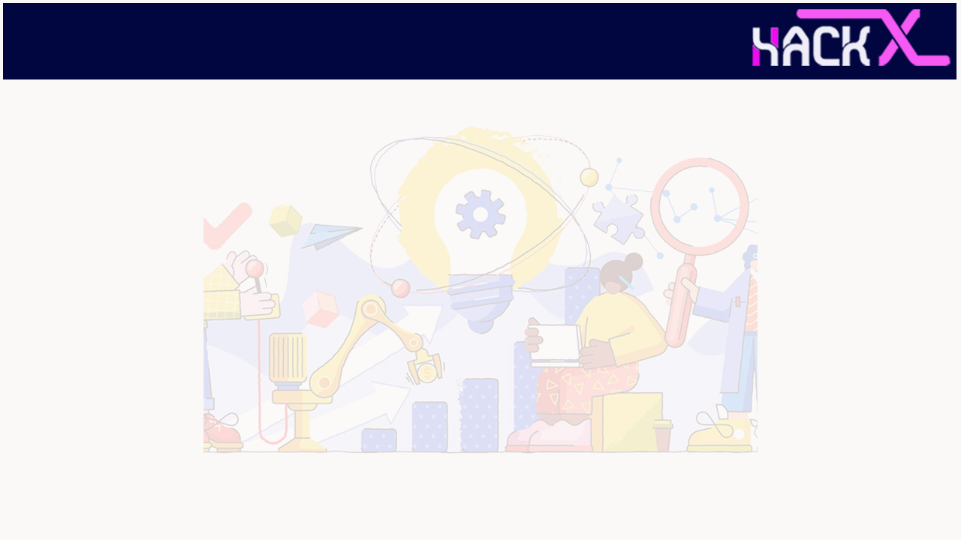
SLIDE 1
1. Team Name: QuadCode
2. Team Members:
Monalisa Maiti [Team Leader] : +91 9651963424
Himanshu Shah : +91 7588324730
Shreya Markhedkar : +91 9591824566
Rajan Iyer : +91 7000778575

Slide 2
SLIDE 2
3. Domain Name: Wearable Technology
4. Problem statement: A solution to bridge the communication gap between the old people and their children or caretakers in the emergency situations and also monitoring the health of the old people like SP-O2 level, heart rate, step monitor, location monitoring along with that any new innovation is encouraged.

Slide 3
SLIDE 3
ABSTRACT
Our smart watch enables the children and caretakers to monitor the health of the elderly. We provide a solution to bridge the communication gap between them and take fast action during emergencies. This will be convenient for use by old people. It will be very useful for people with amnesia or dementia.
We are using components like NodeMCU esp32, MAX30100 pulse Oximeter and MPU6050 to execute our idea. We believe that our innovation may prove to be very life-changing.

Slide 4
SLIDE 4
NOVELTY
Our technology provides updates on your location, heart rate, step tracking and blood oxygen levels. It also provides a feature to alert your loved ones in case of emergencies. It contains a separate emergency button to support our motive.

Slide 5
SLIDE 5
TECHNOLOGY
STACK
From the hardware point of view, the main component of our system will be ESP32. Various sensors like Max30100(Pulse oximeter) for measuring pulse rate and Spo2 levels, it will also have a MPU6050 which will be used for monitoring steps and can also help for fitness tracking, it will also send the location. The main feature is an emergency button, which will send alerts. All the data from ESP32 will be uploaded on Thingspeak and will be displayed on the website.
As for software, we are using HTML5, CSS3, JavaScript and BootStrap.

Slide 6
SLIDE 6
HARDWARE / SOFTWARE IMPLEMENTATION
We are extracting data from MPU6050 and MAX30100 with the help of NodeMCU esp32. Then we are uploading it on Thingspeak. Later we export the data as a json file and display it on our website using JavaScript. Also we use our website to market our product and increase our outreach.

Slide 7
SLIDE 7
BUSINESS SCOPE
We aim to build a affordable and durable alternative for expensive smart watches. This innovation may prove to be life-changing and we believe that in a few years every elderly will use this for their safety.

